Slide 1
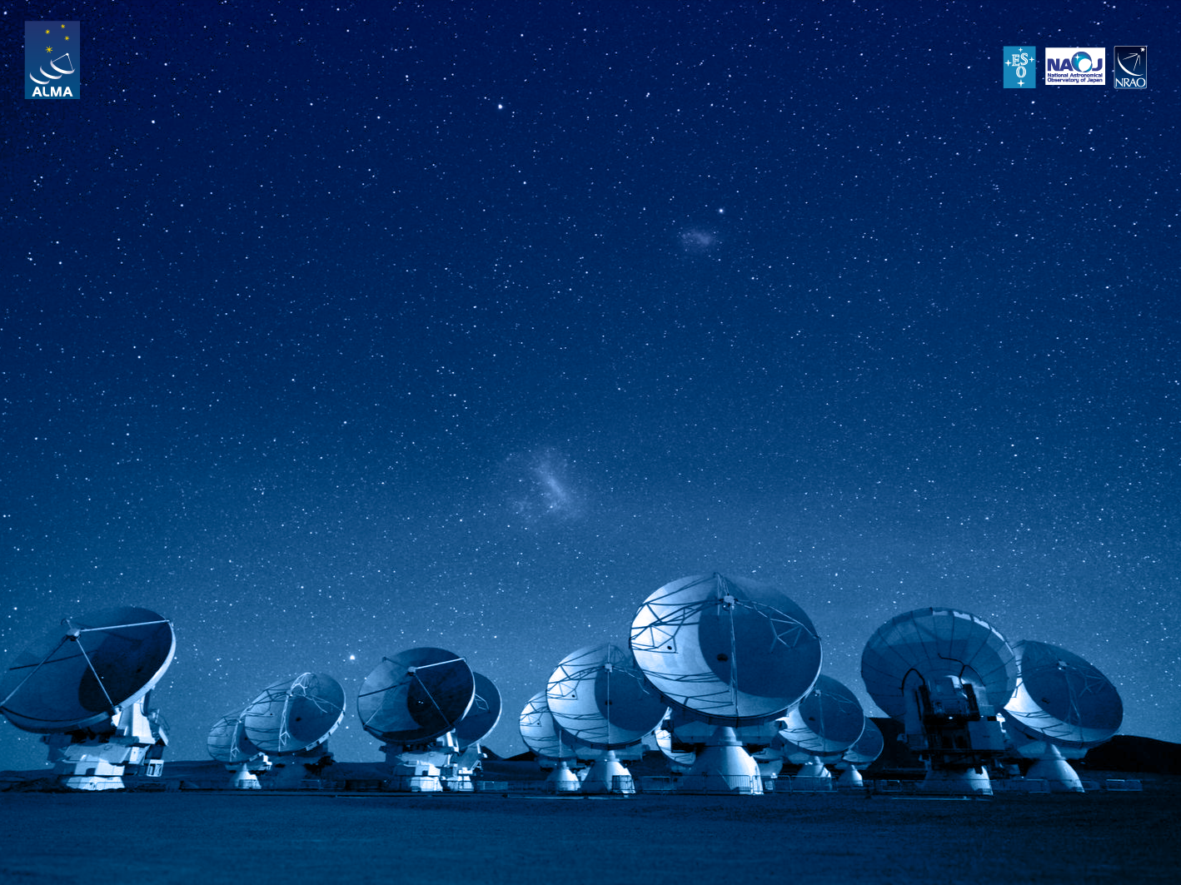
ALMA Common Software Basic Track
Project Lifecycle

Slide 2
Introduction
ACS related development:
Short cycles
Functionalities added incrementaly
Main steps during each cycle:
Requirements capture
Implementation
Integration

Slide 3
Requirements Capture
Goal: group functionalities in high-level “components”, identified by their interfaces
Language independent
Steps:
Requirements identification → Use cases
Interfaces identification and component breakdown
Subsystem/module creation

Slide 4
Implementation (I)
Main steps (not necessarily in sequential order!):
Component IDL interface (language independent)
Component simulation
Component interface implementation (language specific)
Component and high level tests implementation
Component functionality implementation

Slide 5
Implementation (II)
Tests are an integral part of the implementation (test-driven development). The main test layers:
Class level: unit tests
Component level: component tests through IDL interface access
System tests: End-to-end subsystem tests

Slide 6
Implementation (III)
Unit tests
Implementation language specific
Written by component developer
Component tests
Component interface specific
Language independent
Written by component developer or integration team
End-to-end/Subsystem tests
Overall subsystem requirements related
Written by the integration team

Slide 7
Integration
Deploy all the components together in an integrated configuration database (CDB)
Complexity depends on the number of components and interactions between components
Main focus on high-level/end-to-end test execution

Slide 8
And then …
... and start all over again!

Slide 9
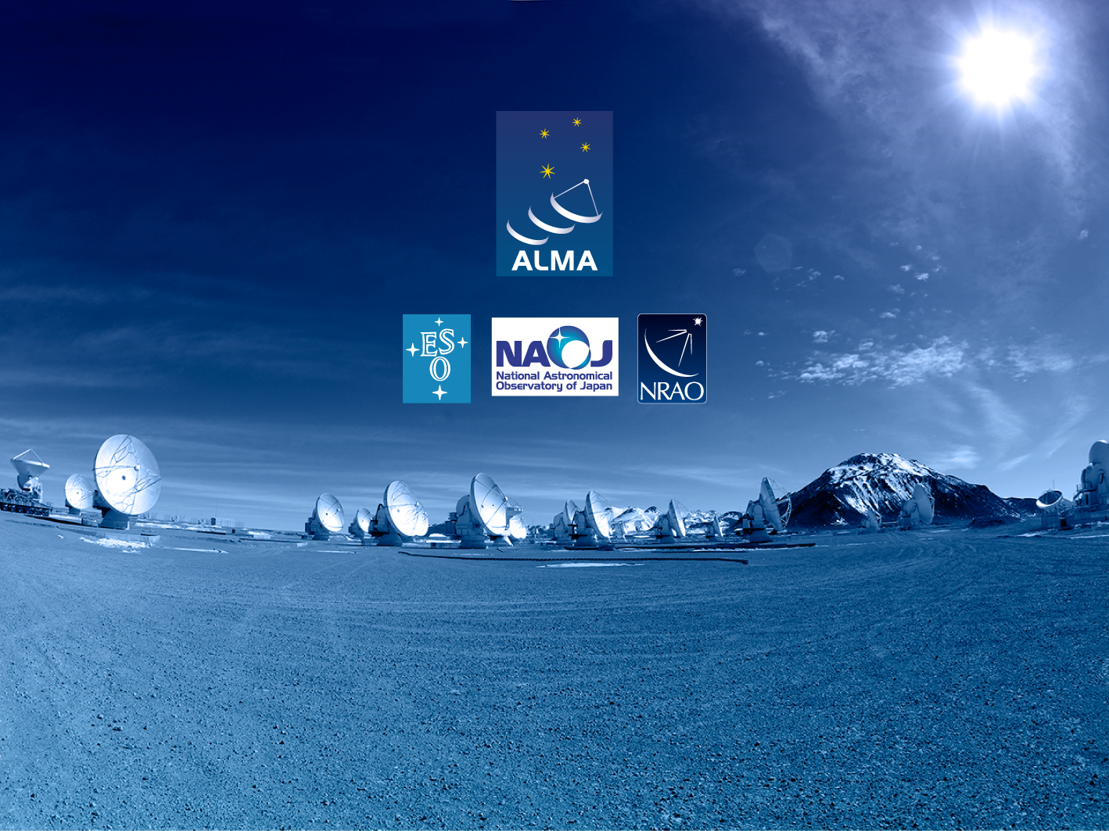
Questions?
Acknowledgements
ACS presentations were originally developed by the ALMA Common Software development team and has been used in many instances of training courses since 2004. Main contributors are (listed in alphabetical order): Jorge Avarias, Alessandro Caproni, Gianluca Chiozzi, Jorge Ibsen, Thomas Jürgens, Matias Mora, Joseph Schwarz, Heiko Sommer.
The Atacama Large Millimeter/submillimeter Array (ALMA), an international astronomy facility, is a partnership of Europe, North America and East Asia in cooperation with the Republic of Chile. ALMA is funded in Europe by the European Organization for Astronomical Research in the Southern Hemisphere (ESO), in North America by the U.S. National Science Foundation (NSF) in cooperation with the National Research Council of Canada (NRC) and the National Science Council of Taiwan (NSC) and in East Asia by the National Institutes of Natural Sciences (NINS) of Japan in cooperation with the Academia Sinica (AS) in Taiwan. ALMA construction and operations are led on behalf of Europe by ESO, on behalf of North America by the National Radio Astronomy Observatory (NRAO), which is managed by Associated Universities, Inc. (AUI) and on behalf of East Asia by the National Astronomical Observatory of Japan (NAOJ). The Joint ALMA Observatory (JAO) provides the unified leadership and management of the construction, commissioning and operation of ALMA.

